Slide 1

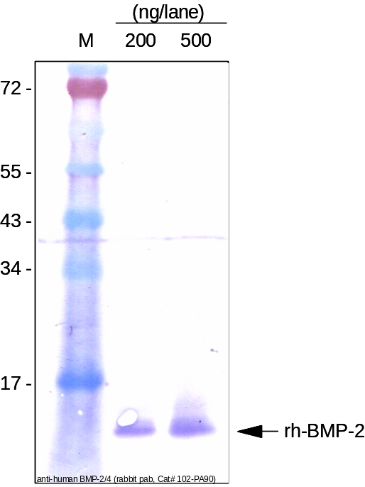
ReliaTech GmbH
Anti-human BMP-2
(Cat#102-PA106)
Figure 1: Western analysis of recombinant human BMP-2 under reducing conditions.
http://www.reliatech.de / orders@reliatech.de

